Slide 1
BLOCKCHAIN TRANSACTIONS
BY REKHA BHARATHIMANGALAM RAMACHANDRAN

Slide 2
PROJECT
This project demonstrates the creation and testing of blockchain transactions

Slide 3
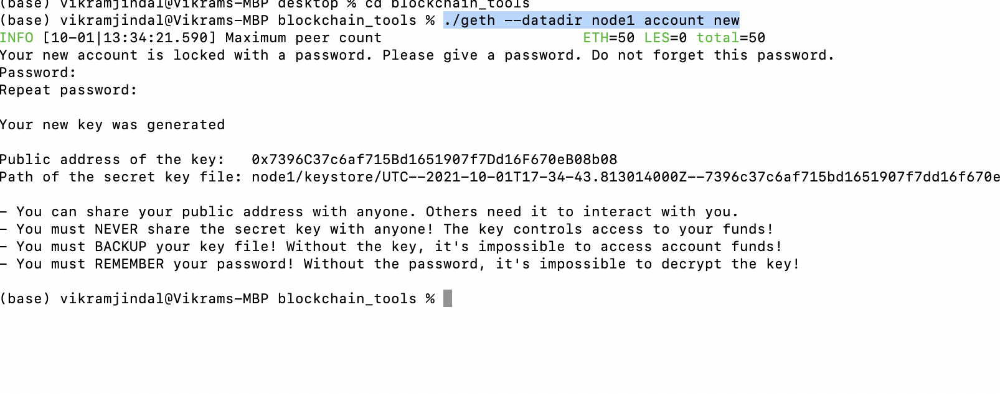
Creation of the first Node1/Account
Create account/Node1 using the terminal at the folder where geth & puppeth functions are installed.
* ./geth --datadir node1 account new
Provide a password to unlock the Node 1/Account. Remember it for future use.
Copy the public address and private key generated in a text file for future use.

Slide 4
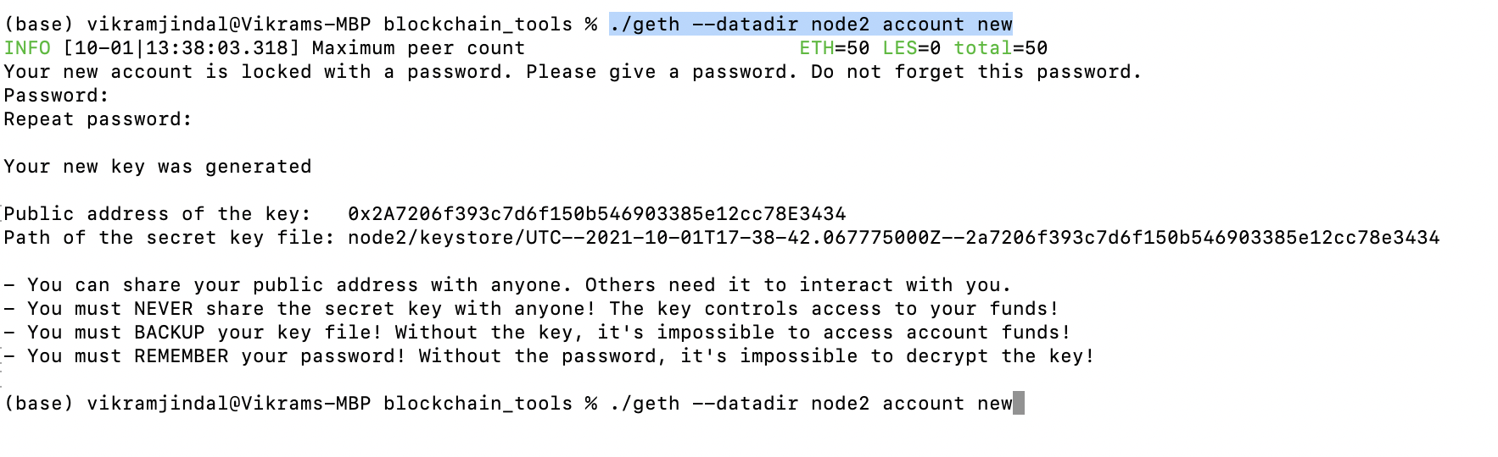
Creation of the Second Node2/Account
Next Create the Node 2/Account at the terminal using geth command
./geth --datadir node2 account new
Provide a password to unlock the Node 2/Account. Remember it for future use.
Copy the public address and private key generated in a text file for future use.

Slide 5
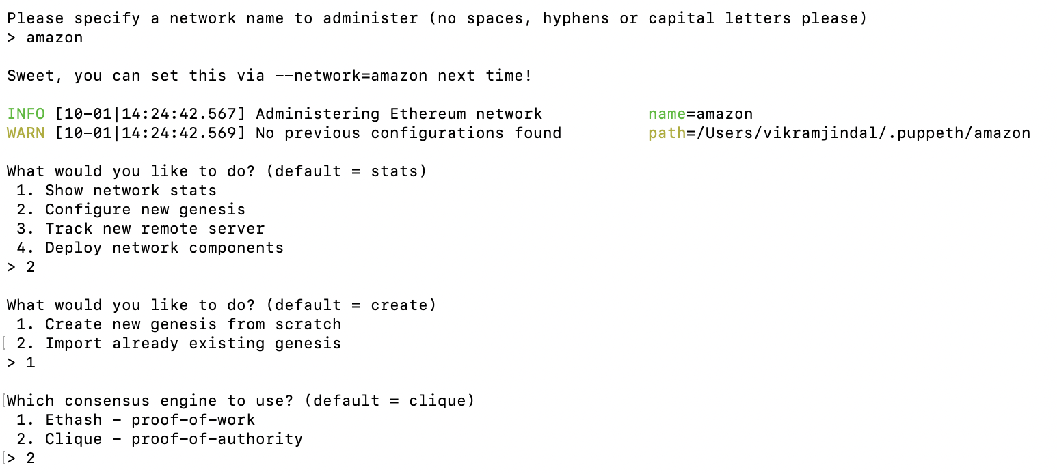
Create & Configure Genesis Network
Next, generate your genesis block.
Run `puppeth`, name your network(Ex:amazon), and select the option to configure a new genesis block.
Choose the `Clique (Proof of Authority)` consensus algorithm.

Slide 6
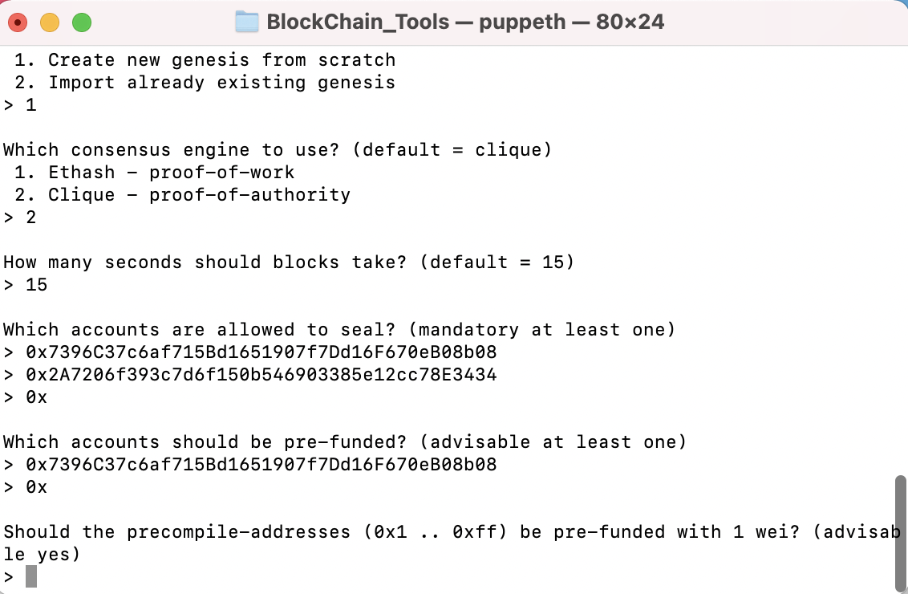
Seal & Prefund the Accounts
Paste both account addresses from the first step one at a time into the list of accounts to seal.
Paste them again in the list of accounts to pre-fund. There are no block rewards in PoA, so you'll need to pre-fund.
Continue with the default option for the prompt that asks, Should the precompile-addresses (0x1 .. 0xff) be pre-funded with 1 wei?
Complete the rest of the prompts, and when you are asked to choose a folder for the network update a folder name.(Ex: amaz)
At the main menu, choose the "Manage existing genesis" option
Complete the Export genesis configurations. This will fail to create two of the files, but you only need `networkname.json`.(Ex: “amazon.json”)

Slide 7
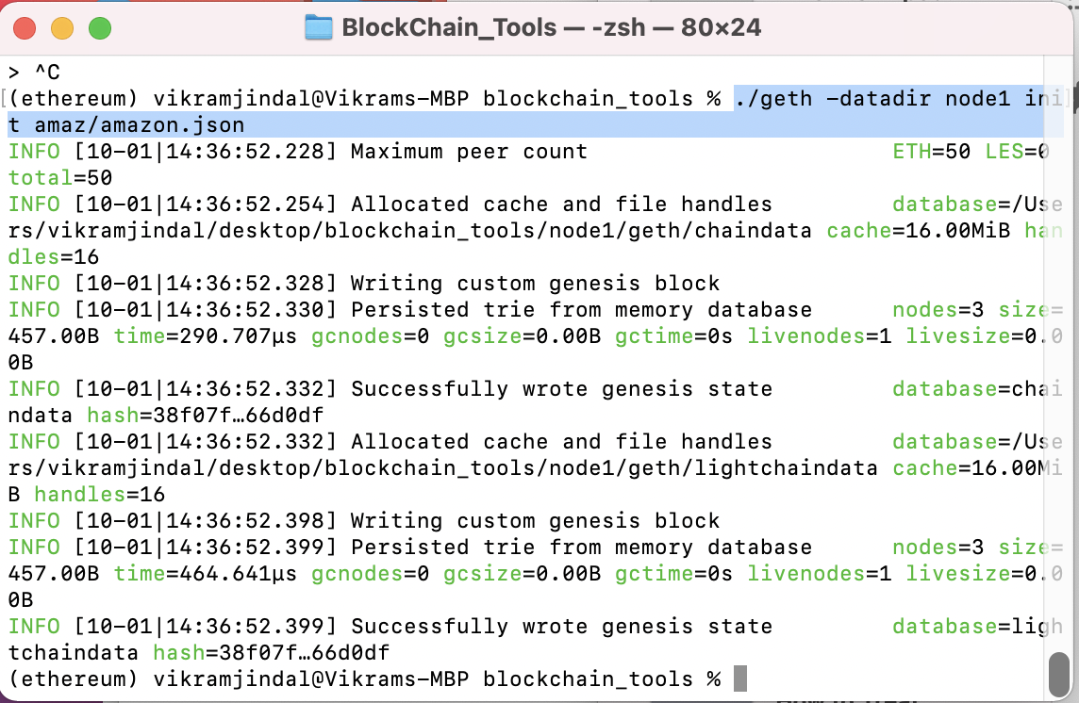
Initialize Node1/Account
We will now initialize the node1 with the genesis' json file.
Using `geth`, initialize each node with the new `networkname.json`.
* ./geth --datadir node1 init networkname.json
(Ex : ./geth --datadir node1 init amaz/amazon..json)

Slide 8
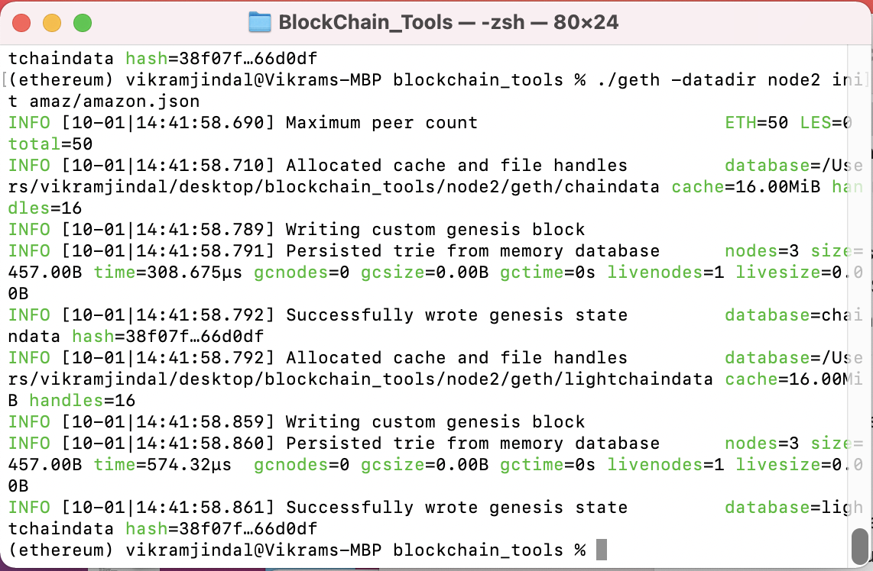
Initialize Node2/Account
Initialize the node2 with the genesis' json file.
./geth --datadir node2 init networkname.json
(Ex : ./geth --datadir node2 init amaz/amazon..json)

Slide 9
RUN The NODES/Account
Now the nodes can be used to begin mining blocks.
Run the nodes in separate terminal windows with the commands:
* ./geth --datadir node1 --unlock "SEALER_ONE_ADDRESS" --mine --rpc --allow-insecure-unlock
* **NOTE**:SEALER_ONE_ADDRESS is your Node1 public key
* ./geth --datadir node2 --unlock "SEALER_TWO_ADDRESS" --mine --port 30304 --bootnodes "enode://SEALER_ONE_ENODE_ADDRESS@127.0.0.1:30303" --ipcdisable --allow-insecure-unlock
**NOTE**:SEALER_TWO_ADDRESS is your Node2 public key
***NOTE**enode://SEALER_ONE_ENODE_ADDRESS@127.0.0.1:30303" is generated when Node 1 is RUN
(Ex:enode://91f912b9e8a9677c355c65e701c148471eda188dc097d1d3d5e2c9d7f9c2c6baa602fc04dcb9a15d8394e75bb63f992cb2267fe1b8e68156546949cbd2de8c32@127.0.0.1:30303)
* **NOTE:** Type your password and hit enter - even if you can't see it visually!

Slide 10
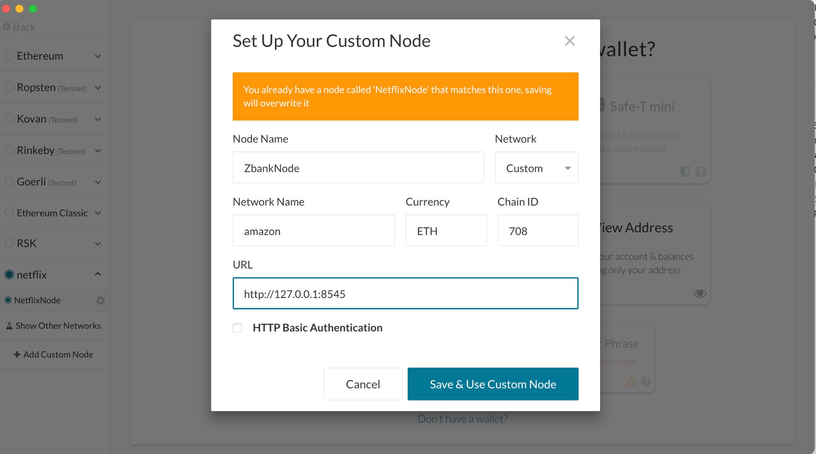
Set up your custom node in MyCrypto
Your private PoA blockchain should now be running!
With both nodes up and running, the blockchain can be added to MyCrypto for testing.
Open the MyCrypto app, then click `Change Network` at the bottom left:
Click "Add Custom Node", then add the custom network information that you set in the genesis.
Make sure that you scroll down to choose `Custom` in the "Network" column to reveal more options like `Chain ID`:
Type `ETH` in the Currency box.
In the Chain ID box, type the chain id you generated during genesis creation.
In the URL box type: `http://127.0.0.1:8545`. This points to the default RPC port on your local machine.
Finally, click `Save & Use Custom Node`.

Slide 11
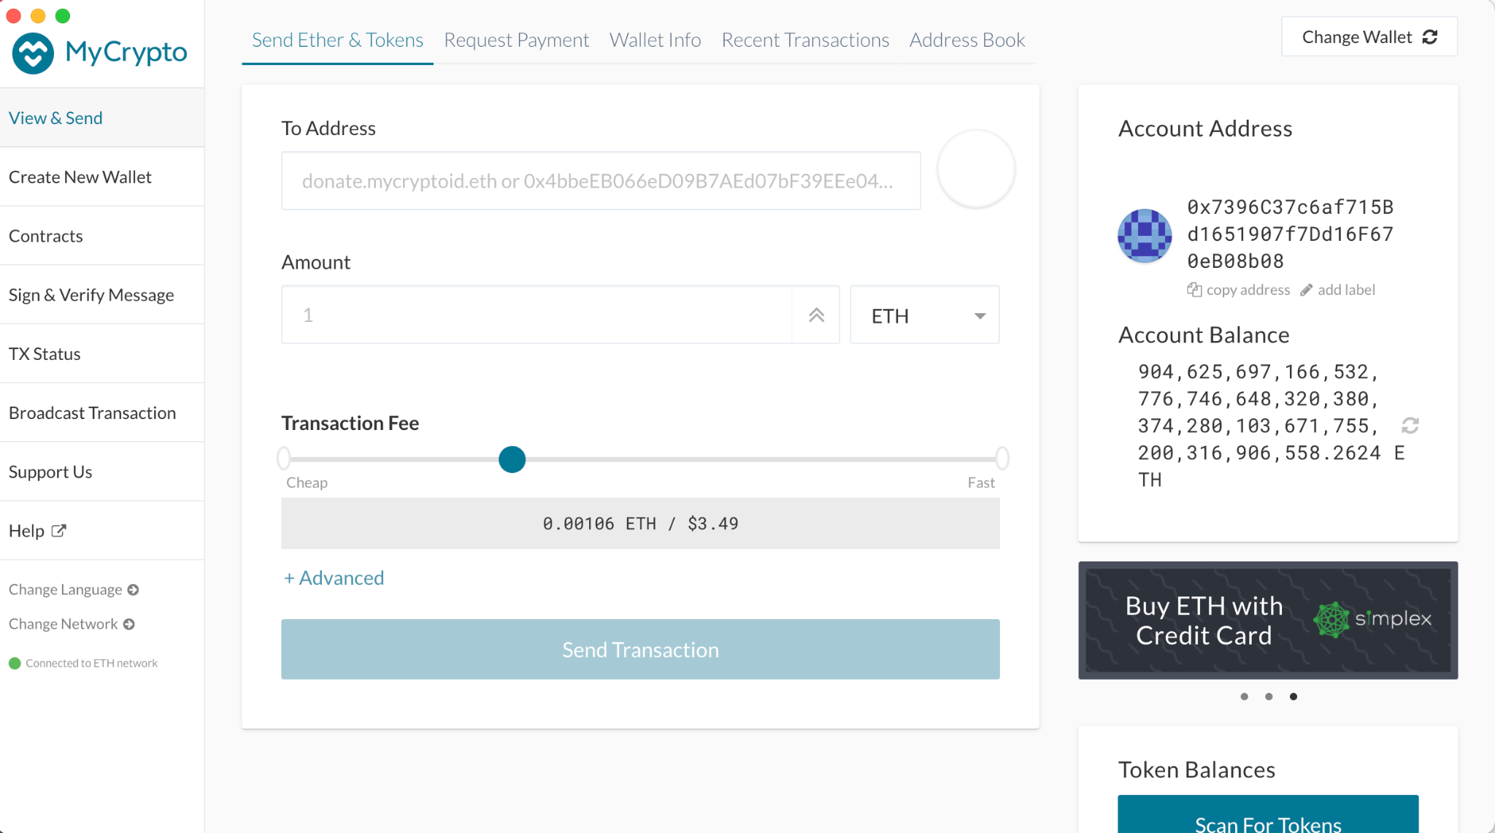
View Prefund ETH Amount in MyCrypto
In View & Send Select Keystore file
Next Select Wallet Info
Go to your prefunded Node(Ex:Node 1) to your keystore folder select the file.
Enter Node password when requested(Ex: Node 1)
Press Unlock
You are filthy rich !!!

Slide 12
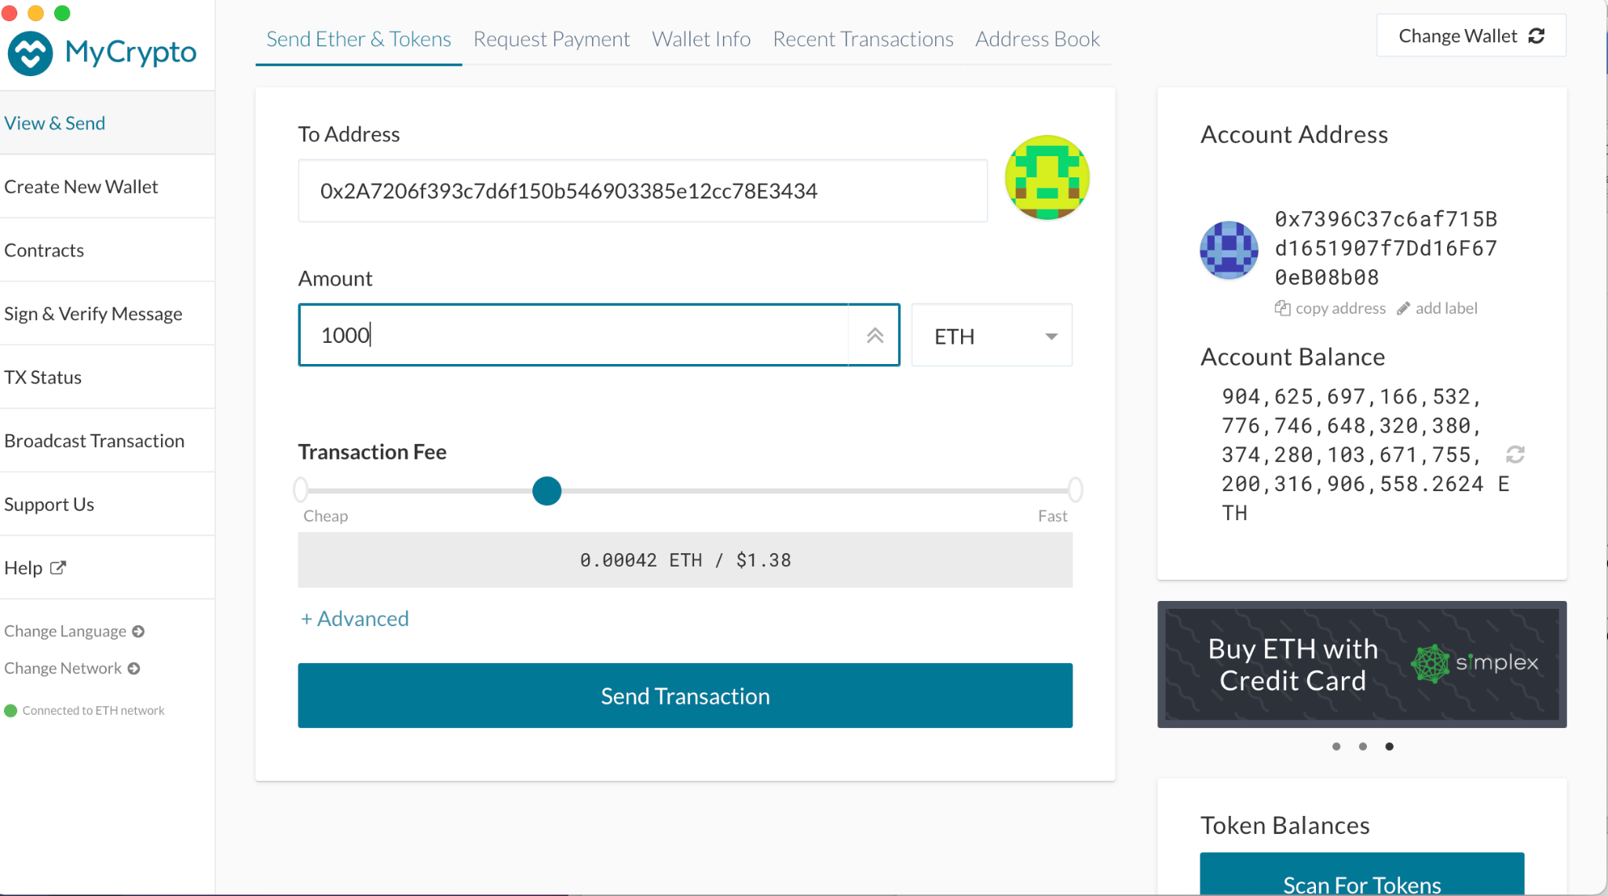
Transfer ETH Amount To Recipient
Select Send Ether & Tokens
Enter To address (Ex:Node 2 Public Key)
Enter amount (Ex:1000)to transfer.
Click on Send Transaction

Slide 13
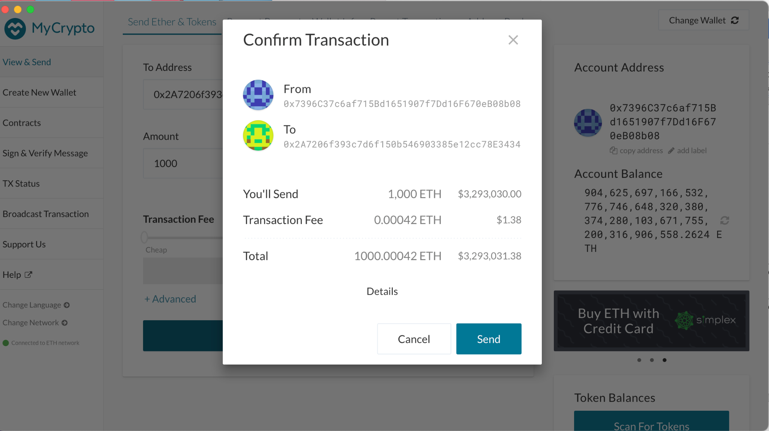
Confirm ETH Transaction in MyCrypto
Verify the from address(Ex: Node1 public key) and To address(Ex: Node2 public key)
Verify ETH amount transferred(Ex:1000).
Click the Send Button

Slide 14
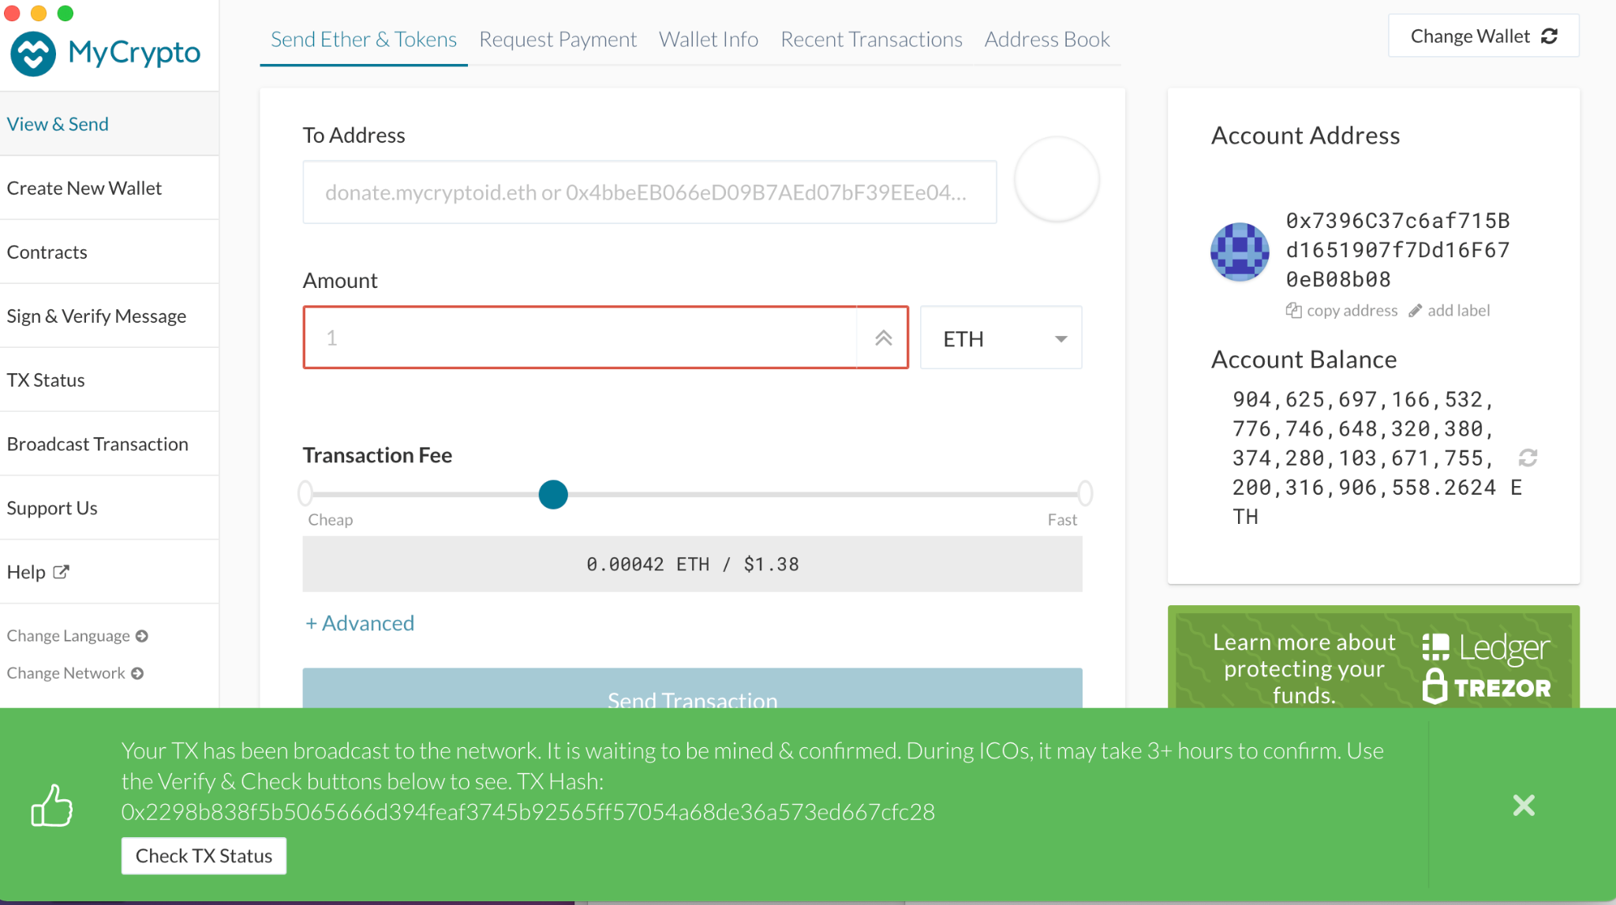
Check Transaction Status in MyCrypto
To check the transfer of ETH amount click on the CheckTxStatus.

Slide 15
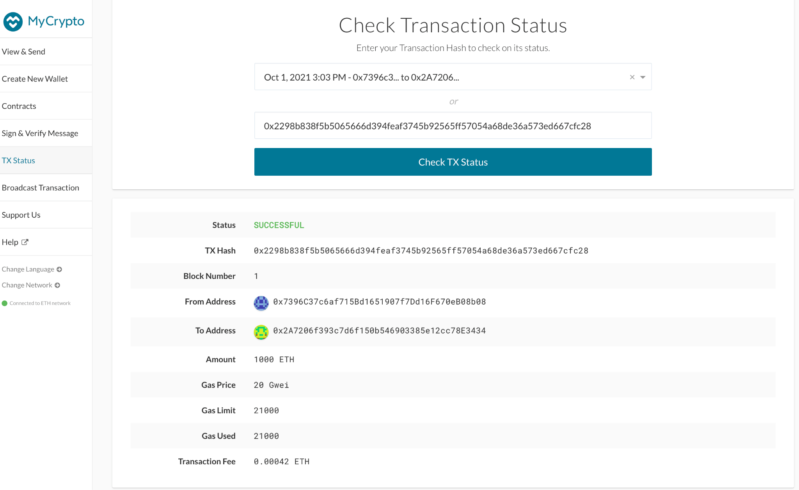
Transaction Success in MyCrypto
Select the transaction in the dropdown box
Else, you can update the TxHash in the box
Click on Check Tx Status.
Status should display Success.
This completes the transfer of ETH amount to the recipient address (Ex: Node 2)

